Slide 1
ENR497: B.Tech. Engg. Project
School of Engineering & Applied Science
(Winter 2023)

Slide 2
Developers’ Hub Job Recommendation System
Krunal Savaj AU1940271
Asite Solutions Pvt Ltd.
Duration:
1st week of January to 1st week of May 2023
26-02-23
Krunal Savaj

Slide 3
Outline of Presentation
Motivation
Literature survey
Overall objectives of the project
Proposed outcomes of the project
Proposed methodology for implementing/completing the project
Gantt chart showing plan during March and April 2023
Novelty in the project / Your contributions in the project
Who will benefit from your work
26-02-23

Slide 4
Motivation
Empowering freelancers and clients to connect, collaborate, and thrive in a global marketplace, unlocking limitless opportunities and driving economic growth through a seamless digital platform.
Why MERN Stack?
Scalability and Flexibility: MERN stack allows for easy scalability and flexibility due to its modular architecture and ability to handle large amounts of data. With MongoDB as the NoSQL database, it offers horizontal scalability, while Node.js provides high-performance and scalable applications.
JavaScript Full-Stack: MERN stack offers a unified JavaScript-based technology stack for efficient development and code sharing
Features & Key Differences
Project based pricing/Hourly Pricing
Biding Method
Features such that Student can use application
26-02-23

Slide 5
Literature survey(Requirements)
Freelancers
• Sign up as a Freelancer
• Create and manage profile
• See the list of positions that are open
• If interested in the job, express your interest in working on the job
• Communicating with business providers
• Get notified if selected from the recommended list.
Business Providers
• Registration
• Publish a Job
• Browse Jobs (New, in Progress, and Completed)
• Receive Recommended Freelancers for the Work(Content Based Filtering)
• Browse Freelancers Available
• Browse Freelancers Who Showed Interest in the Job
• Confirm the Job with the Preferred Freelancer
• Communicate with freelancers
26-02-23

Slide 6
Relevant Tools and Technologies
Frontend: The user interface is created, views are handled, and components are managed using React.js.
Backend: Express.js and Node.js are used to build server-side functionality, manage API routes, and communicate with databases.
Database: For storing and retrieving data, MongoDB is used as a NoSQL database.
Redux: Redux is a state management tool that enables centralized, predictable data flow throughout the application.
Testing : Postman: A versatile platform for comprehensive API testing, debugging, and collaboration in one place.
This stack offers solution that makes use of Redux for state management while facilitating effective development between the frontend and backend components.
26-02-23

Slide 7
Objectives of the project
Develop a user-friendly platform that facilitates seamless communication and collaboration between freelancers and clients.
Enhance the platform's reputation system to foster trust and credibility among users.
Get the right choice of freelancers for the hiring by implementing strong recommendation system.
Making Such a platform in which Students also can join as a independent freelancers and get experience in real life projects.
Continuously innovate and improve the platform by incorporating user feedback and staying up-to-date with industry trends.
26-02-23

Slide 8
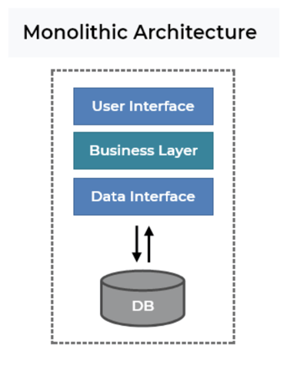
Methodology
System Architecture :
This project follows to monolithic architecture. An application is formed as a single, autonomous unit under a monolithic architectural. A monolithic architecture would mean that frontend and backend of the program are created and implemented as a single entity.
Software Development Method : Scrum
26-02-23

Slide 9
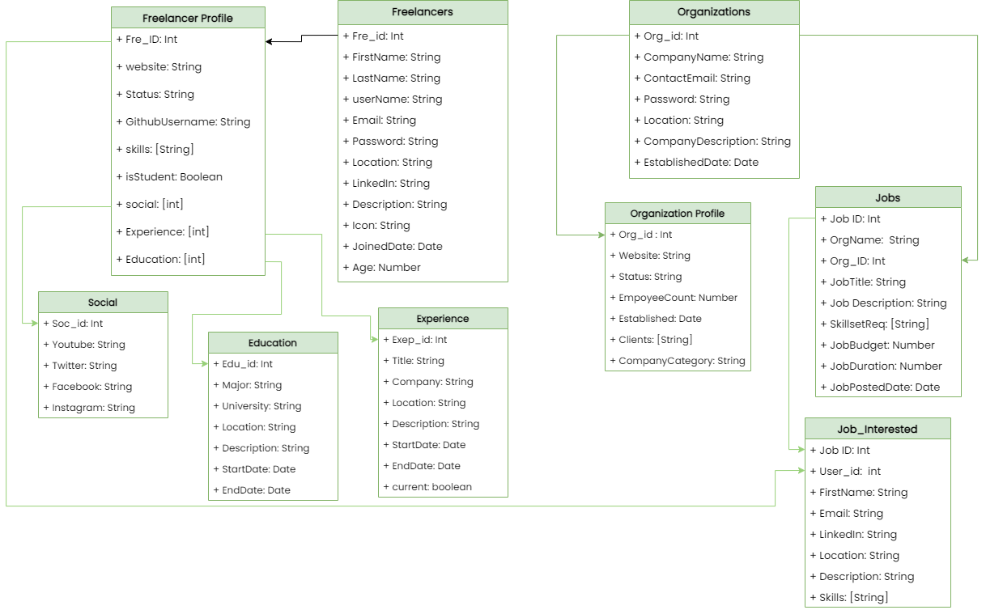
Class Diagram
26-02-23

Slide 10
Your contributions in the project
Defined project objectives, features, and target audience through brainstorming and conceptualization.
Created a comprehensive project plan outlining developmental phases and checkpoints.
Developed system architecture, including frontend components, backend APIs, and database structure.
Implemented frontend using React.js, focusing on responsive design and integrating interactive elements.
Managed server-side development using Node.js and Express.js, ensuring effective communication and integration between frontend and backend components.
26-02-23

Slide 11
Learning outcomes for you
Developed expertise in frontend and backend development, focusing on user interfaces and client-server communications.
Designed scalable, performant, and maintainable application architectures for accommodating large user bases.
Acquired implementation skills in user management, authentication, and authorization for secure access control.
Demonstrated effective project management abilities, prioritizing tasks, collaborating with teams, and meeting deadlines.
Overcame obstacles, resolved bugs, and gained experience in troubleshooting and optimizing code.
26-02-23

Slide 12
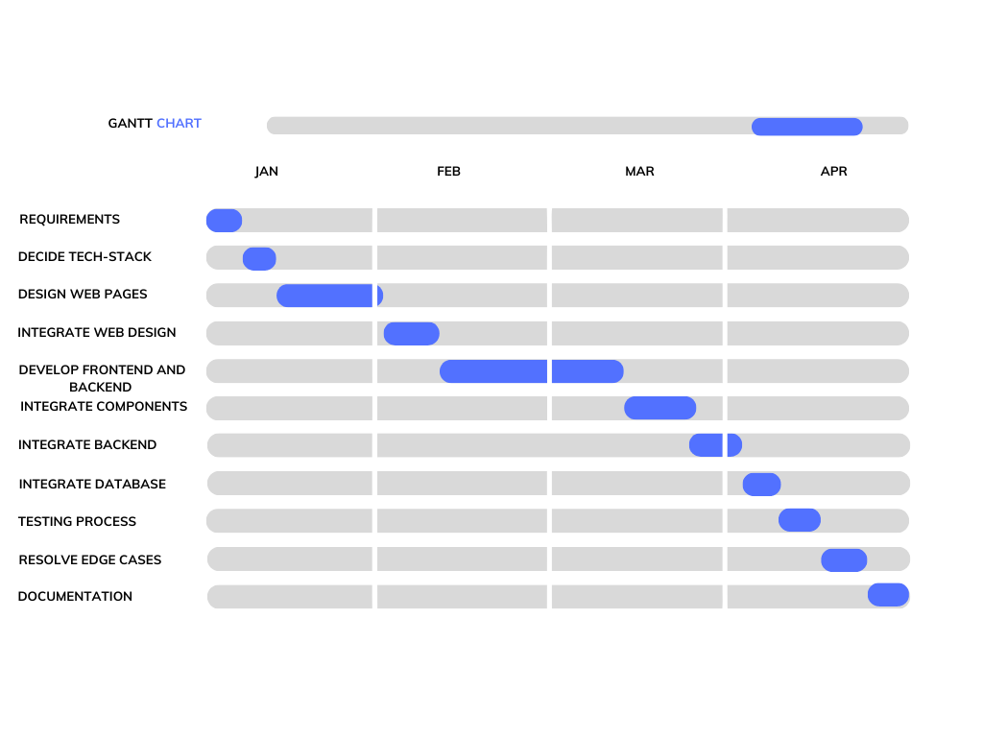
Gantt chart – plan March and April 2023
26-02-23

Slide 13
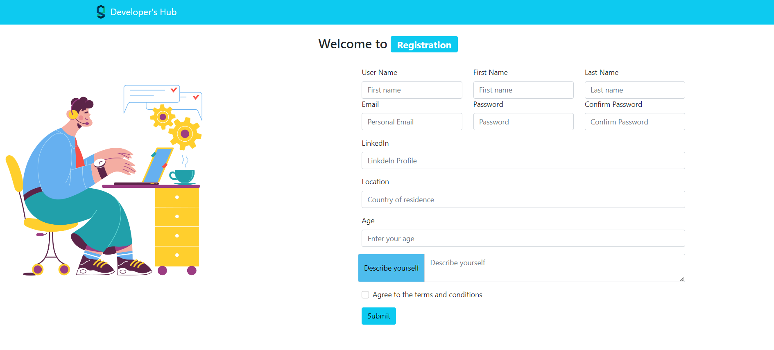
Project Outcomes
Registration Page:
26-02-23

Slide 14
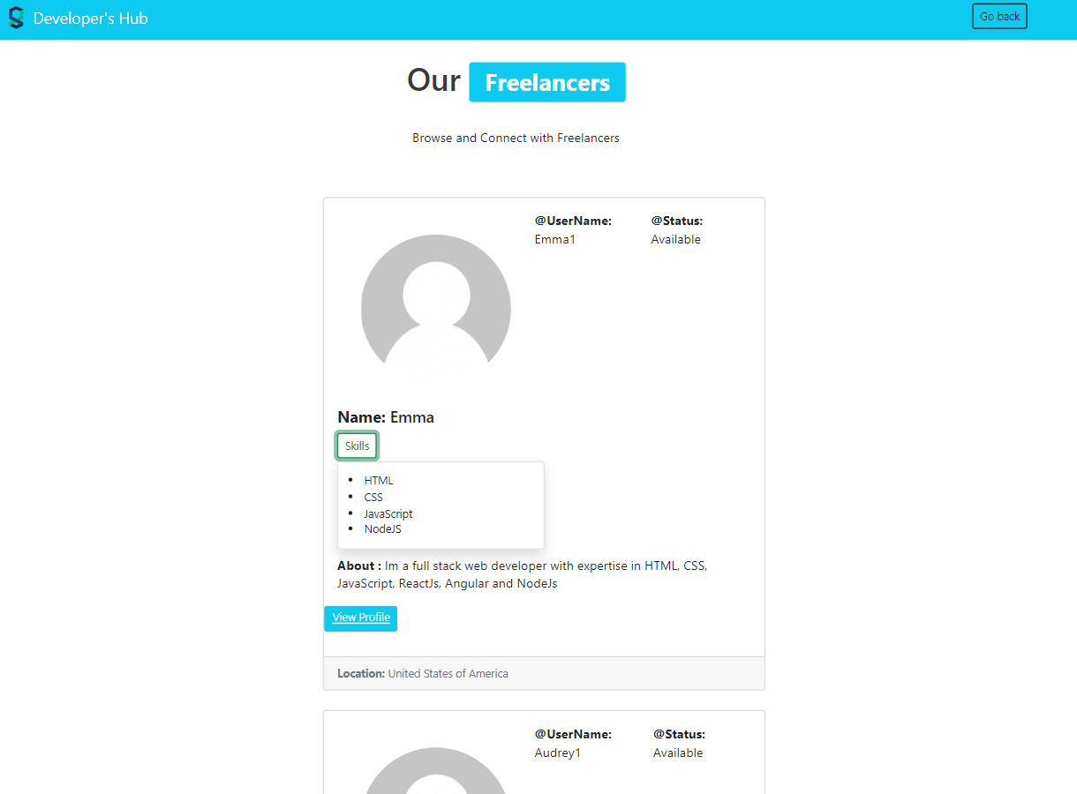
Project Outcomes
View All Freelancer
26-02-23

Slide 15
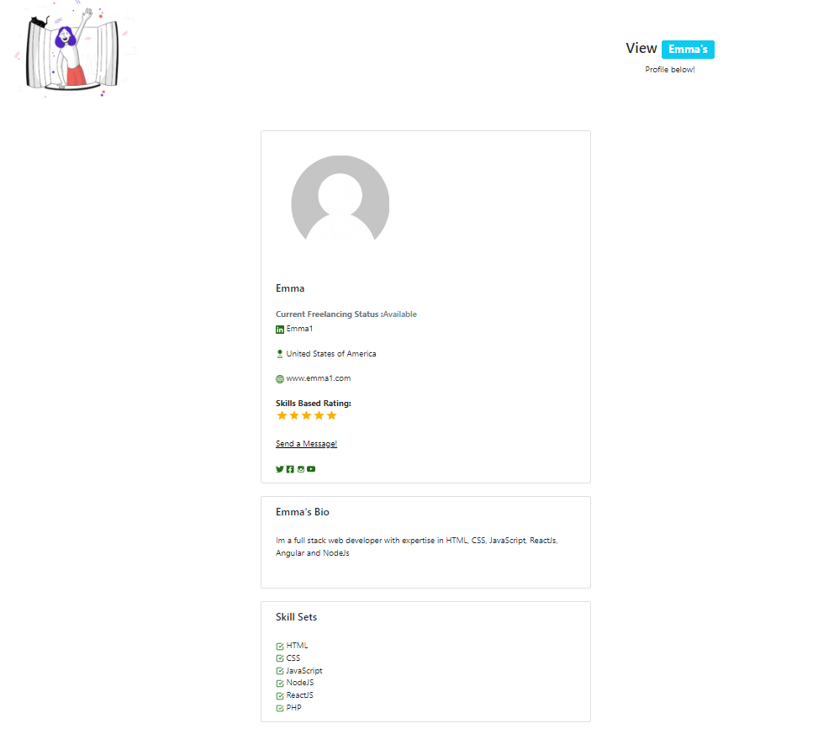
Project Outcomes
See One particular Freelancer’s Profile
26-02-23

Slide 16
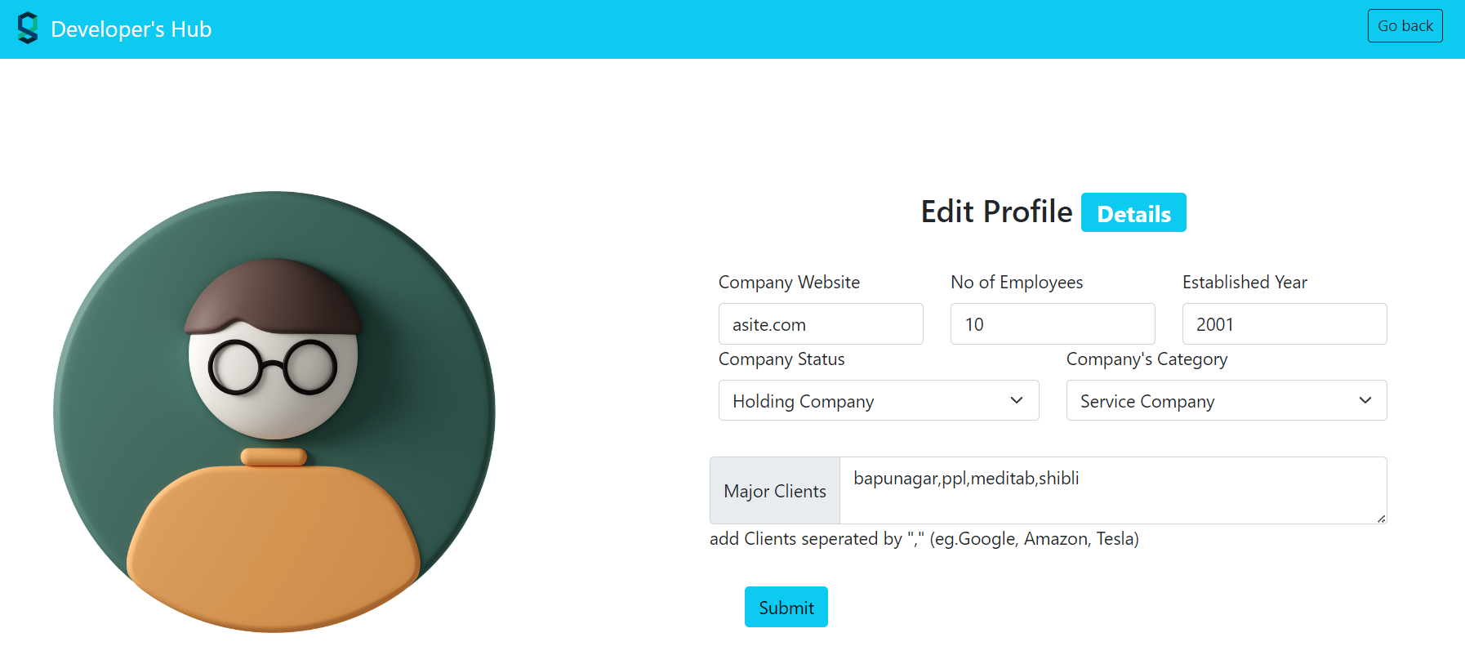
Project Outcomes
Edit Profile option for Business Organization
26-02-23

Slide 17
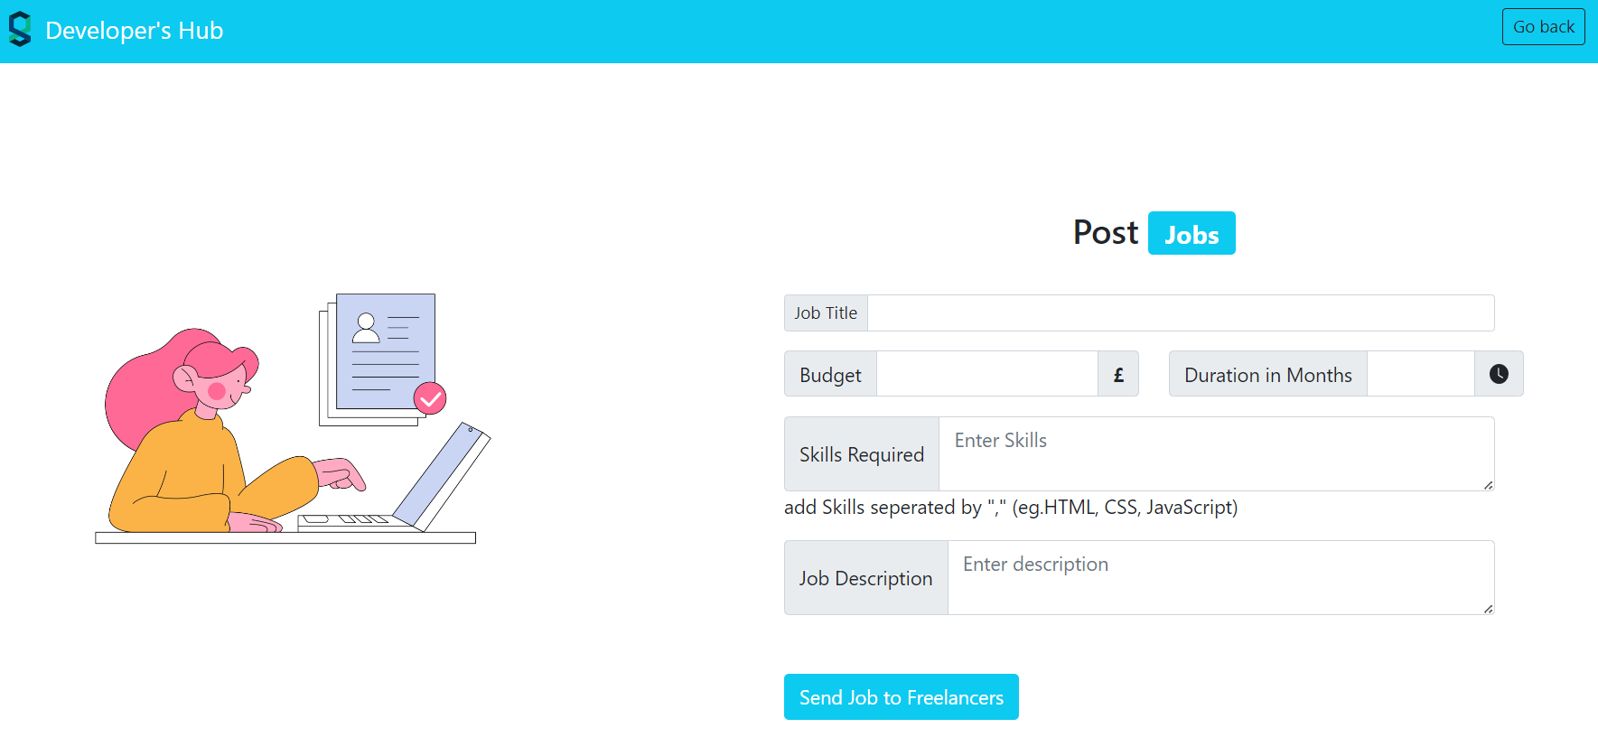
Project Outcomes
Posting a Job
26-02-23

Slide 18
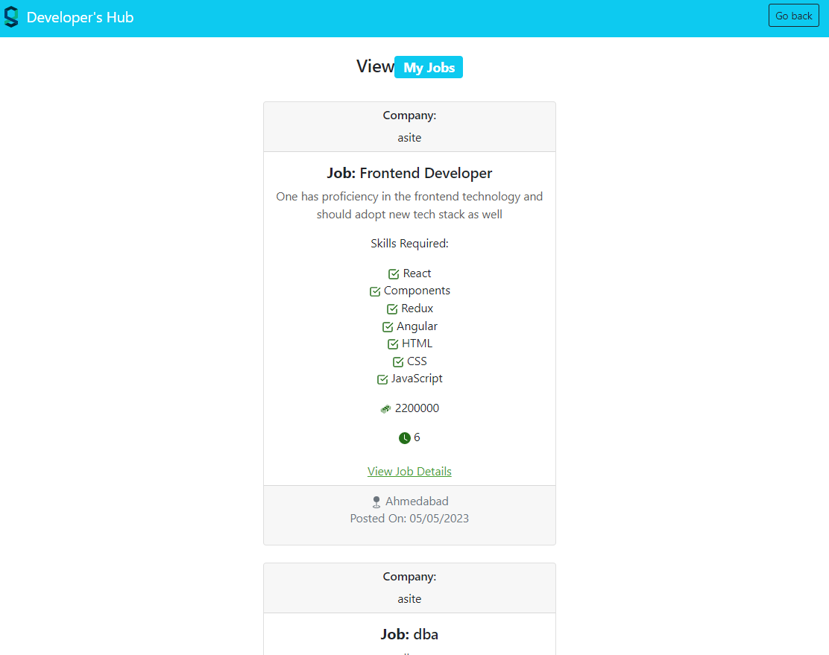
Project Outcomes
See all the posted job by one particular Organization
26-02-23

Slide 19
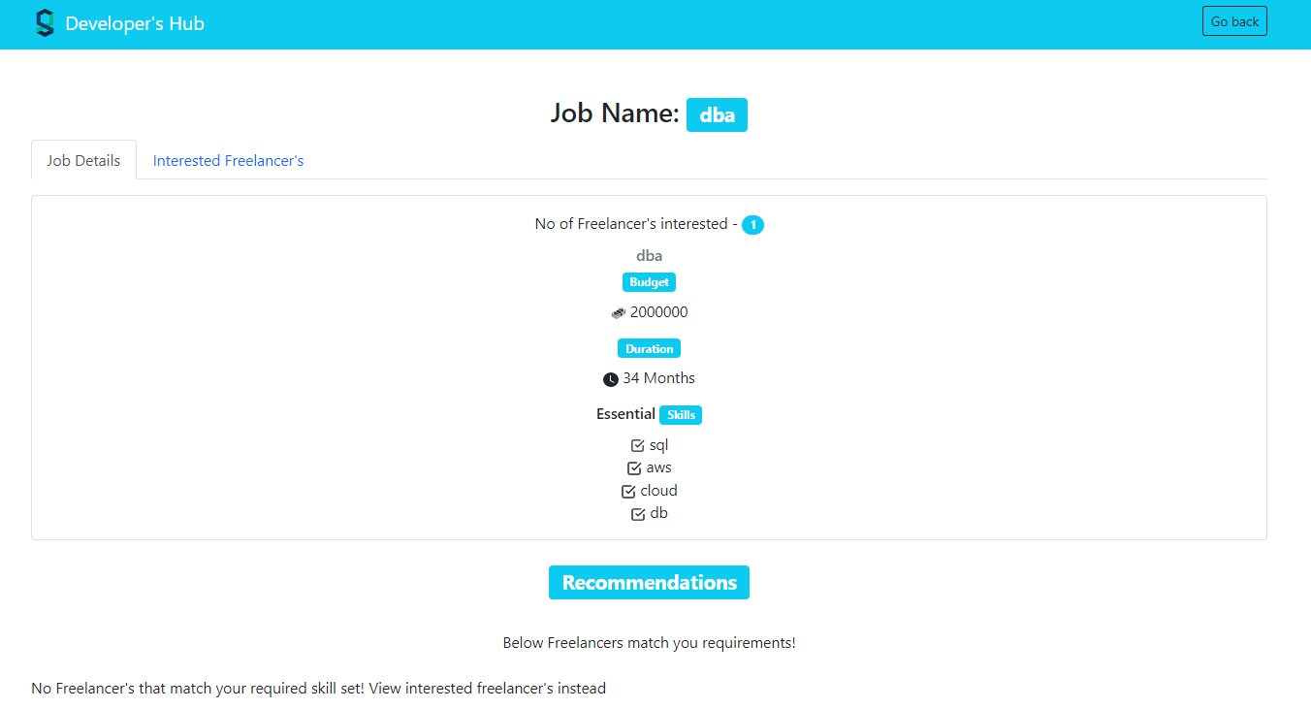
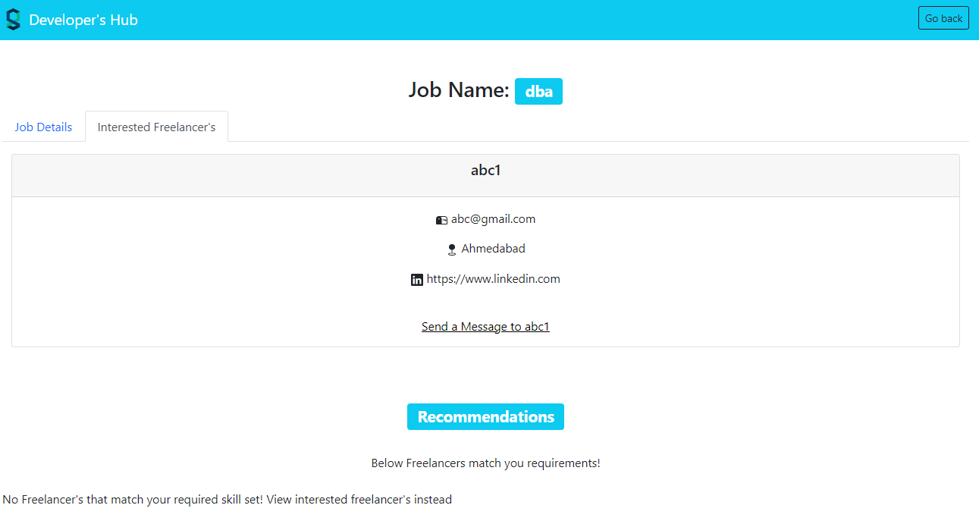
Project Outcomes
See the details of one particular Job
26-02-23

Slide 20
Who will benefit from your work
Small and medium size Enterprises
Students
Freelancers
Employees who want to work on different technologies
Any societal benefits?
Decrement in Unemployment
26-02-23

